Slide 1


Making Recovery Real Partnership, Moray:
Creating an evaluation
framework for the
partnership

Slide 2
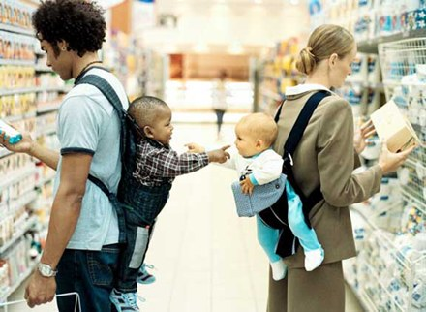

Slide 3

Tell me what you do for fun outside work…. and why? (jot it down on a post it note!)

Slide 4
Today
Understanding our activities and our reach
Generate outcomes based on our activities
Order our outcomes
Developing indicators
Involving people
Action planning
Notes:
Introduce self & ESS
Flag up ESS role
Purpose of the session
Ground rules.
Outline of morning
Refer to purpose and agenda.

Slide 5
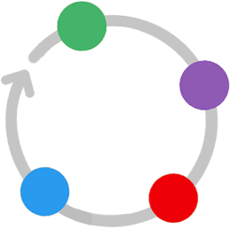
Setting outcomes and indicators
Collecting evidence
Evaluation Pathway
Analysing and reporting
Learning from findings
Notes:
ESS’ evaluation pathway Evaluation isn’t a one-off task. It’s a cyclical process built into everyday work. This means it can:
inform the work of funded orgs
improve lives of individuals – be more responsive to people’s needs
Helps third sectors gather as they go
People tend to jump straight to methods (“Oooh, evaluation – let’s have a questionnaire”). But think it through so you are sure you collect the kind of evidence you need.

Slide 6

What would happen if the partnership didn’t exist?
What difference do you make?
Why are your services needed?
What makes a your services excellent?
What kind of things are most important for people who use services?
key concepts

Slide 7
Outcomes…
are the changes or difference you want to make through your services or activities
Outcomes should link directly to the identified need / problem to be solved
Notes:
This is ESS’ definition of outcomes. This course focuses on outcomes which are relevant to your clients. So put yourself in their shoes. (eg: intermediaries - imagine what the organisations you work with will be like once they’ve changed as a result of your help.)
Why outcomes matter…
You need to know what you are trying to change before you can evaluate to see if you have made a difference.
Your clients will know what they can realistically expect to gain from working with you.
Many funders want to pay for outcomes. They want to know what difference their money makes and how it helps target groups have a better life.

Slide 8
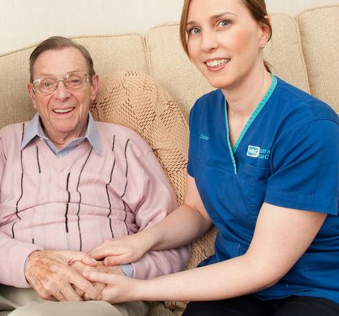
Need / Problem to be solved
  Older people in South Ayrshire have to go into care homes when they’d rather stay at home.
Outcome
  Older people in South Ayrshire are able to stay in their own homes for longer.
Activities
  provide daily personal care
  in people’s homes
  operate a community
  alarm service
  provide respite services
  for family carers

Slide 9
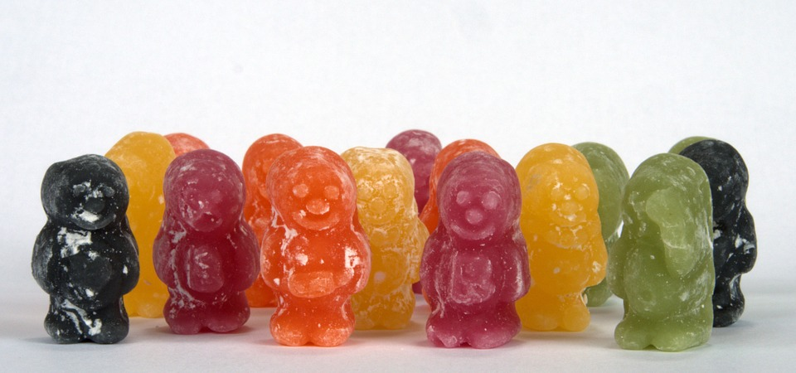
Writing outcomes
Who is changing?
What is changing?
How is it changing?
e.g. Young people (who) are less (how) isolated (what)
Notes:
Outcomes should include the who, what & how of change.
People often forget to include the “who”! You know who you are working with, but other people might not. Be explicit.
“How” refers to the direction of change (increase, decrease etc) NOT how you will make it happen (activities or services).

Slide 10
Use of words
Outcomes
Activities
Decrease
Increase
Improve
Expand
Reduce
Sustain
Support
Engage
Help
Encourage
Offer
Enable
Notes:
Outcomes have “change” words. Activities are described using “action” / “doing” words.
“Sustain” IS a change word if without your project things would have got worse (eg “people at risk of homelessness sustain their tenancies”

Slide 11

More examples
Carers are better able to cope
Homeowners have reduced fuel bills
Learners are more able to move into employment
Notes:
3 examples (reveal) – can identify for each:
Who is changing?
What is changing?
How is it changing?

Slide 12
The “So What?” test
I ran a training workshop – So what?!
You attended – So what?!
You enjoyed yourself – So what?!
You became better at writing outcomes 
You became more confident about evaluation 
You are now better able to explain your
project’s impact 
Notes:
The “so what?” question can help you work out whether or not you’ve written an outcome (as opposed to an activity).
Outcomes should answer the ‘so what?’ question. Asking the question makes you think about the change that will happen as a result of what you do. It is a “drill down” technique to discover whether or not the thing you are questioning is yet describing change.
[This test is not meant to diminish the importance of the thing being questioned – if it feels like it is then use “What then?” instead.]

Slide 13
Outcomes…
Should be realistic – achievable in a set time scale
Should be in your power to achieve
Not too many and…
be wary of the word “and”!
Don’t worry about how to measure them
yet!

Slide 14
The order of things
Short term
Medium term
Long term

Slide 15
Outcomes over time
Family Welfare Project
People have increased understanding of their rights
People are better able to manage their finances
People have less debt
Strategic outcome: Reduced local poverty
Notes:
Outcomes can be short, medium or long term (as makes sense in the context of your organisation). Outcomes can change over time but the aim won’t.
Impact – Still about change but it is not wholly within your sphere of influence. You can contribute to it but you cannot achieve this change alone in a reasonable amount of time.

Slide 16




Example: Curing a headache
Notes:
Logic Modelling Workshop Jan 2009
16
Simple example
Headache: an overview of the plan
Helps you spot any flaws in the plan e.g. We’re assuming the person has access to pills, that they haven’t already taken pills and forgotten (e.g. someone with dementia may need prompts).

Slide 17
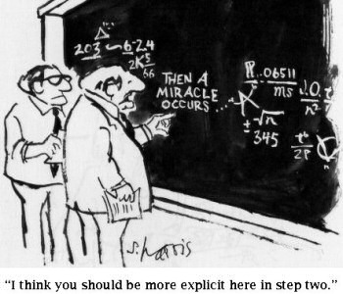
Notes:
Logic Modelling Workshop Jan 2009
17
Often projects are good at saying what they’ll do and the overall difference it will make, but less clear about the links in between.
How did you get there?
Funders want to learn – want to know what steps you took/how you made those changes happen
It can also be motivational for staff to really understand how activities lead to changes

Slide 18

What would it look like if you achieved your outcomes?
Answering this will give you your indicators
Notes:
Indicators help you work out the questions you need answers to and what evidence you need to gather.

Slide 19
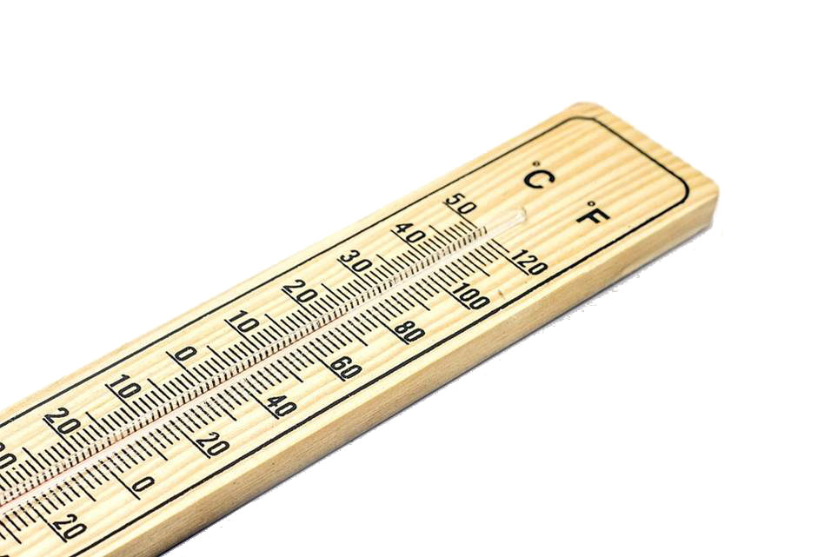
Making indicators useful
Indicators should:
Be simple and
specific
Make sense to your participants
Be able to be measured more than once and show change over time
Notes:
Simple and specific: helps ensure the people who use the evaluation method understand what they are being asked to evidence (the indicator)
Recognisable to service users: helps ensure that the indicators are meaningful and actually represent the changes they experience
Can be measured more than once: Ask the participants why. So can show change (Particularly important if you work with people over a long period of time.)

Slide 20
Indicators
Willingness to suggest ideas
Ability to make eye contact
Enthusiasm for taking part in activities
Young people have increased social skills
Awareness of other people’s needs
Ability to make friends
Notes:
To measure soft outcomes, you need to come up with indicators that can be measured. Get indicators:
by drawing on your experience
by asking your service users
How else might you know someone had increase social skills? What would it look like?

Slide 21

What are your indicators?
Choose one of your outcomes and think of as many indicators as you can
Then circle 4 or 5 key indicators that may be:
  Most important (i.e. if you saw this happening you could be very confident that your outcome is being achieved)
  Likely to occur in most situations
  Easy to measure
Notes:
Work on own project. Using Outcome / indicator template in pack try writing indicators for one of your own soft outcomes. The sheet is double sided if they want to try it for more than 1 outcome.
Once you have a long list, go back and circle 4-5 ‘key indicators’ (those that you will routinely measure, that are most likely to tell you about the outcome happening/easiest to measure)
Likely to occur in most situations
Might be due to your opportunity to know if it’s happening e.g. level of eye contact for a telephone helpline?
Or because it’s a very individual thing e.g. “Davey jumps on a stage to sing a solo for the group” tells us about his confidence level, but probably wouldn’t look for everyone to be able to do it
Whole group activity – Take an example of a soft outcome from one participant (could use the same one as earlier, when looking at outcomes and activities). Brainstorm possible indicators & discuss. Don’t think about how to measure at this stage.
Depending on time = could just share key indicators, or work as a group for a tricky outcome

Slide 22
Where do you get your evidence from?
They tell you
Observed behaviour
Third party tells you
OUTCOME EVIDENCE
Awards and standards
Internal records
Statistics
Notes:
Indicators can give us clues about where to get evidence from and what methods to use.
Interactions
Observation – notes of what you see happening / photos / activity videos…
They tell you / third party tells you – casual feedback, questionnaires, interviews, video diaries, focus groups, mapping exercises, visual tools…
Written Materials
Awards and standards – Badges, checklists, quality standards… (eg care commission report)
Statistics – tracking what happens for comparisons with wider norms/statistics (debt truancy etc).
Internal records – attendance, list of activities, use of services…

Slide 23

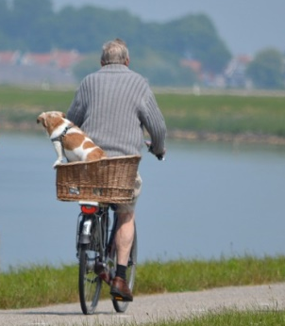

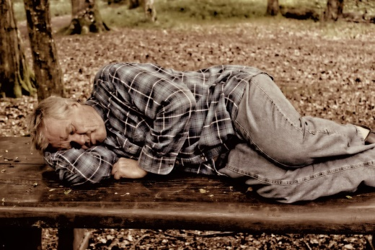
Example
Outcome:
Care home residents are more physically active
Indicators
number of steps taken daily
number of activity sessions participate in
means of getting around care home
length of time can balance on one leg holding onto a chair
feelings of fitness
Methods
pedometers
attendance records
observation / ask people
timed attempt
ask people to move to the picture which best reflects how fit they feel
Notes:
Example of Outcome → Indicators → (appropriate) Methods

Slide 24
Our advice
Have an evaluation plan
Build evidence-gathering into your activities (if possible)
Consider using a range of methods
Test your methods
Collect baseline evidence at the start
Think about long term follow-up
You don’t have to collect information on all your outcomes all the time
Record unexpected outcomes
Notes:
evaluation plan – coming up soon
build into activities - think about the kinds of things you do with your service users anyway – try to integrate evaluation methods if possible (eg if it’s a sports club, get people to run to a particular corner to illustrate how they feel, add prompts to forms you use anyway to remind you about the indicators you are looking for)
range of methods – all have pluses & minuses – as long as you are gathering information about the same indicators it may be OK to use different methods
test your methods – give it a go, don’t be afraid to change if necessary & to be open about this in reports
collect baseline at start – otherwise don’t know if there’s been change
long term follow up – is this appropriate for your service? if so, when & with how many people? is it feasible?
be honest & involve clients – remember “Why bother to involve people in evaluation?”
when to collect what
don’t try to measure medium/long-term outcomes too early
if you always get similar results, you could just check in every so often to make sure nothing’s changed
you could do light-touch evaluation on all your outcomes and focus in more specifically on one outcome at a time
unexpected outcomes – keep an eye open for emerging themes and surprises, these may help you improve your service (what works for who, in what circs?)

Slide 25
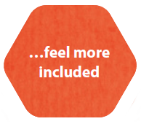
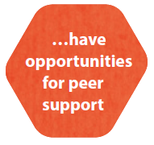
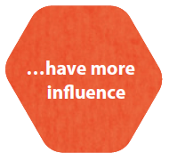



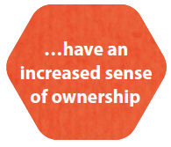
Why bother?
Notes:
Why might you want to bother?

Slide 26
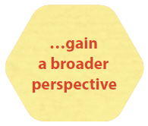
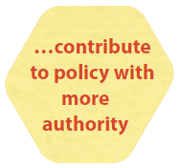




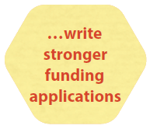
Why bother?

Slide 27

The Spectrum of Involvement
ask people you work with for comments
develop user forums which contribute regularly to evaluation
involve people you work with in planning part of the process
involve people in doing some of the evaluation work
people you work with control the evaluation process
lesser
amount of commitment required
greater
Notes:
Introduce the spectrum

Slide 28

Today we’ve covered
Developed outcomes
Ordered our outcomes
How to generate and write
indicators for your outcomes
Involving stakeholders
Action planning
Notes:
Keep an eye out for unexpected outcomes too – you might be achieving things you didn’t think you would (possibly for other people – eg. volunteers).

